Slide 1
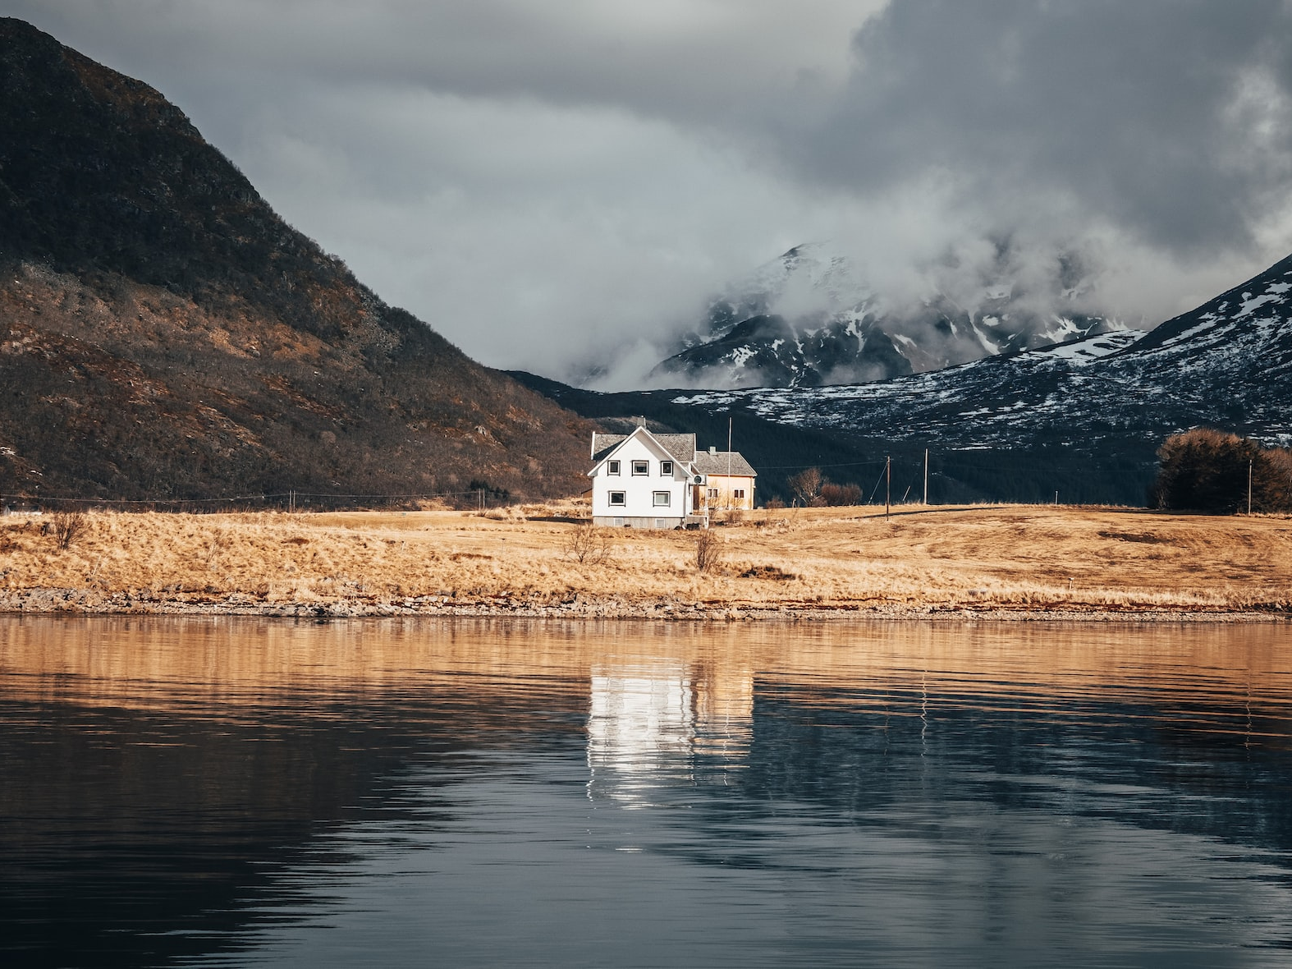
[Article Title]
Hello world Hello world Hello world Hello world Hello world Hello world Hello world Hello world Hello world Hello world Hello world Hello world

Slide 2
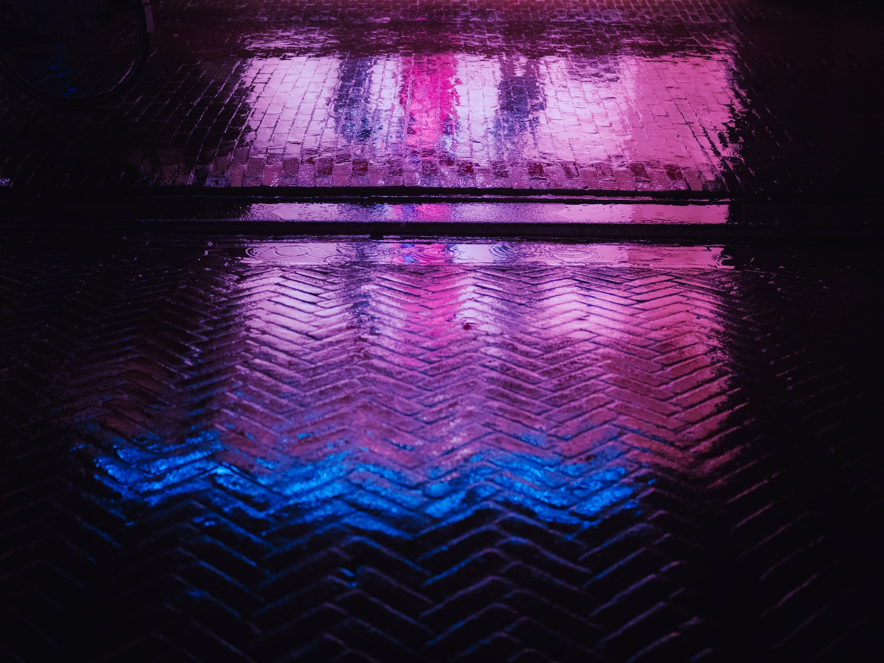
[Article Title]
Hello world Hello world Hello world Hello world Hello world Hello world Hello world Hello world Hello world Hello world Hello world Hello world

Slide 3
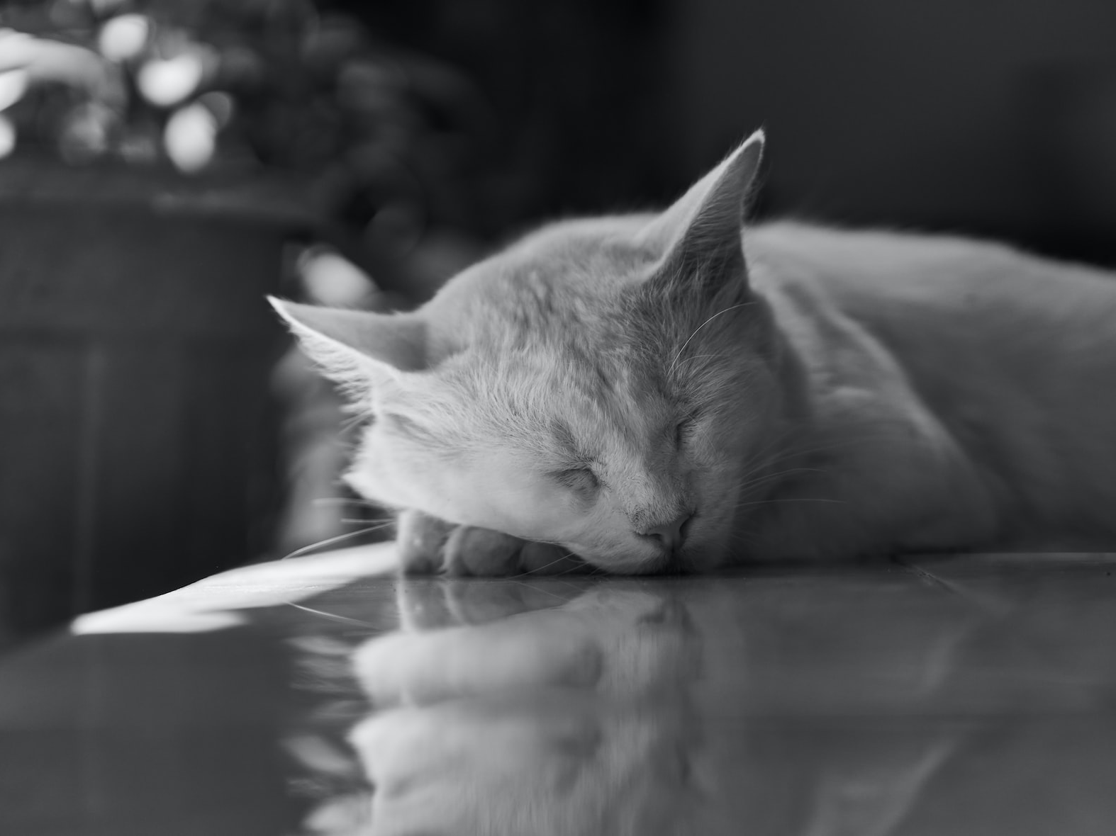
[Article Title]
Hello world Hello world Hello world Hello world Hello world Hello world Hello world Hello world Hello world Hello world Hello world Hello world

Slide 4
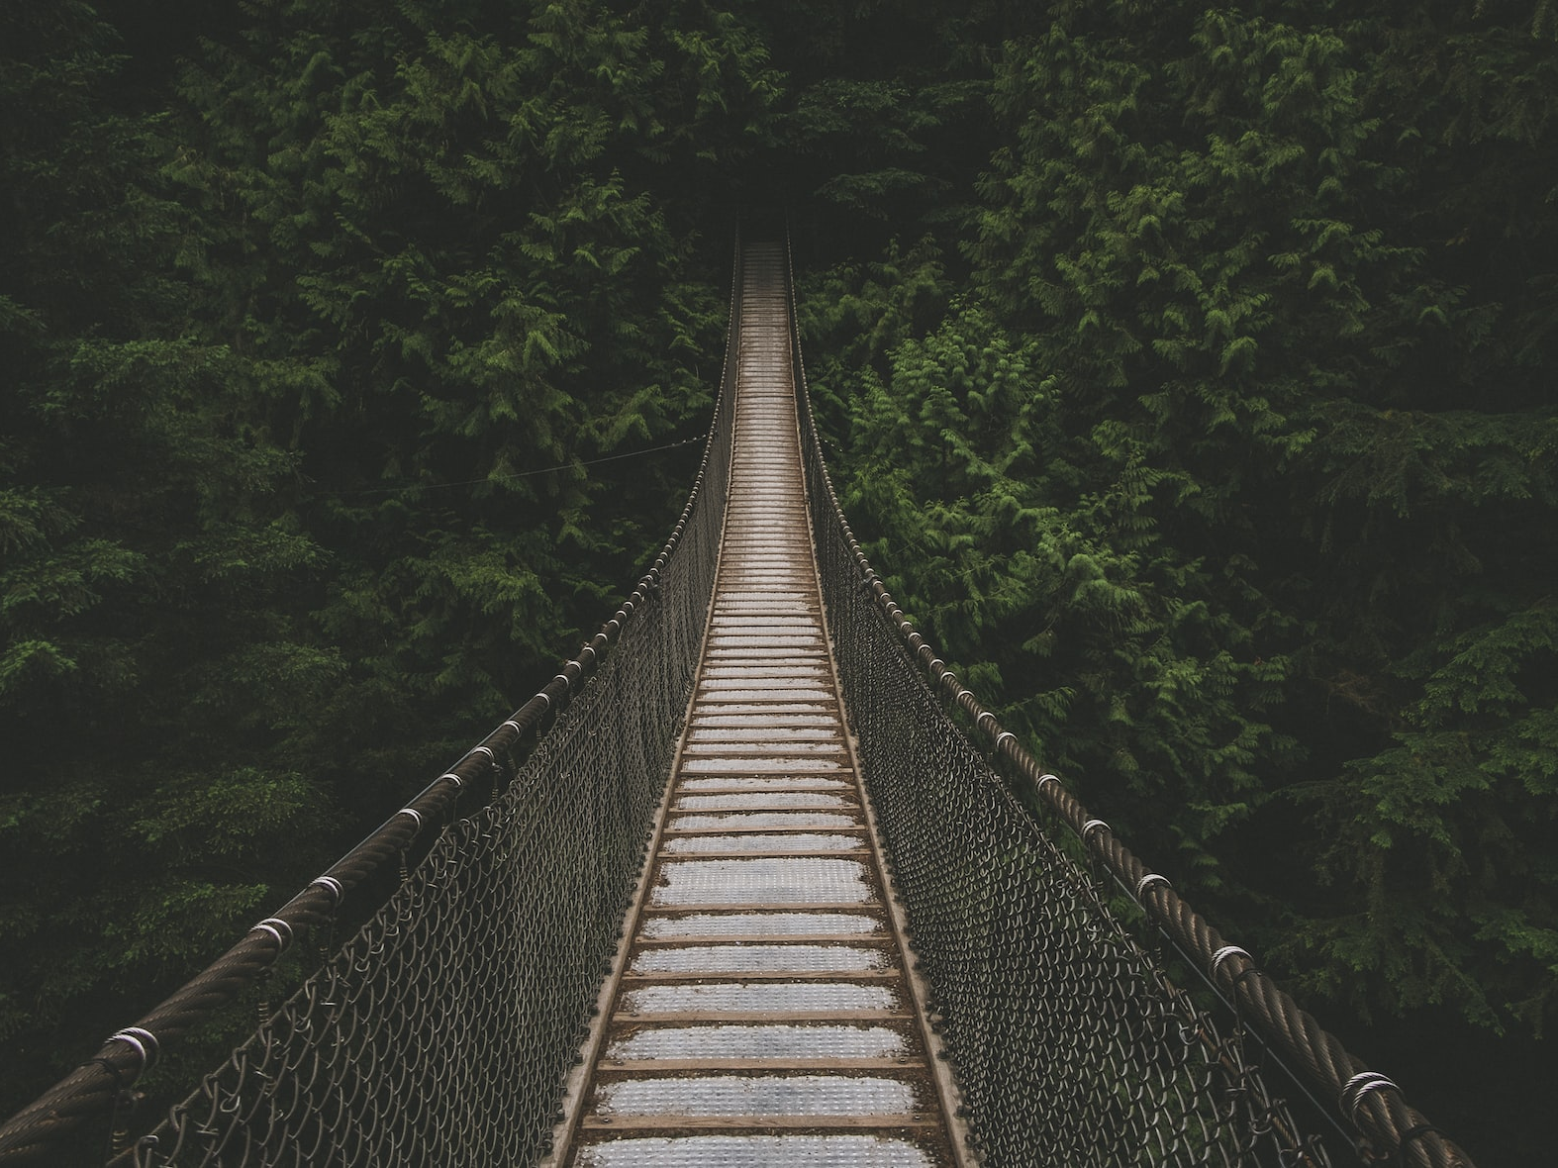
[Article Title]
Hello world Hello world Hello world Hello world Hello world Hello world Hello world Hello world Hello world Hello world Hello world Hello world

Slide 5
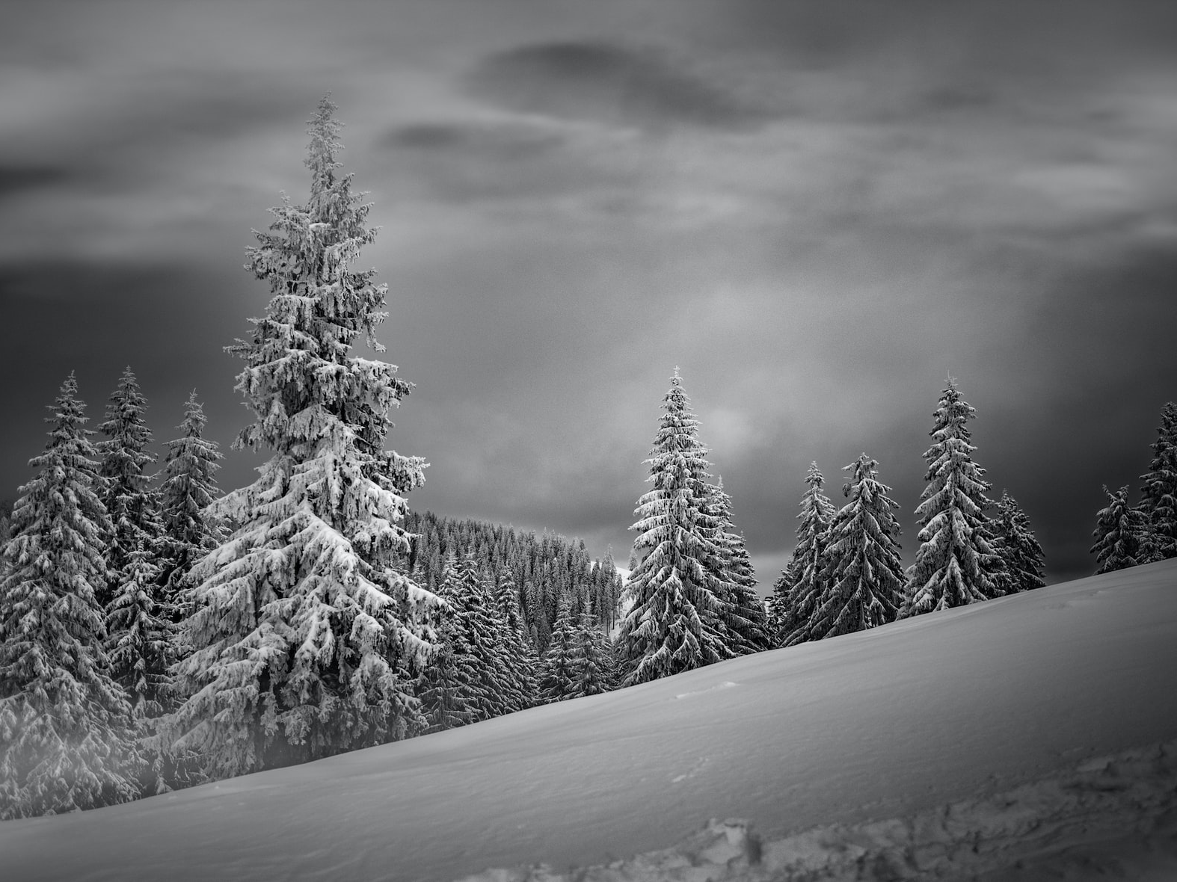
[Article Title]
Hello world Hello world Hello world Hello world Hello world Hello world Hello world Hello world Hello world Hello world Hello world Hello world

Slide 6

[Article Title]
Hello world Hello world Hello world Hello world Hello world Hello world Hello world Hello world Hello world Hello world Hello world Hello world

Slide 7
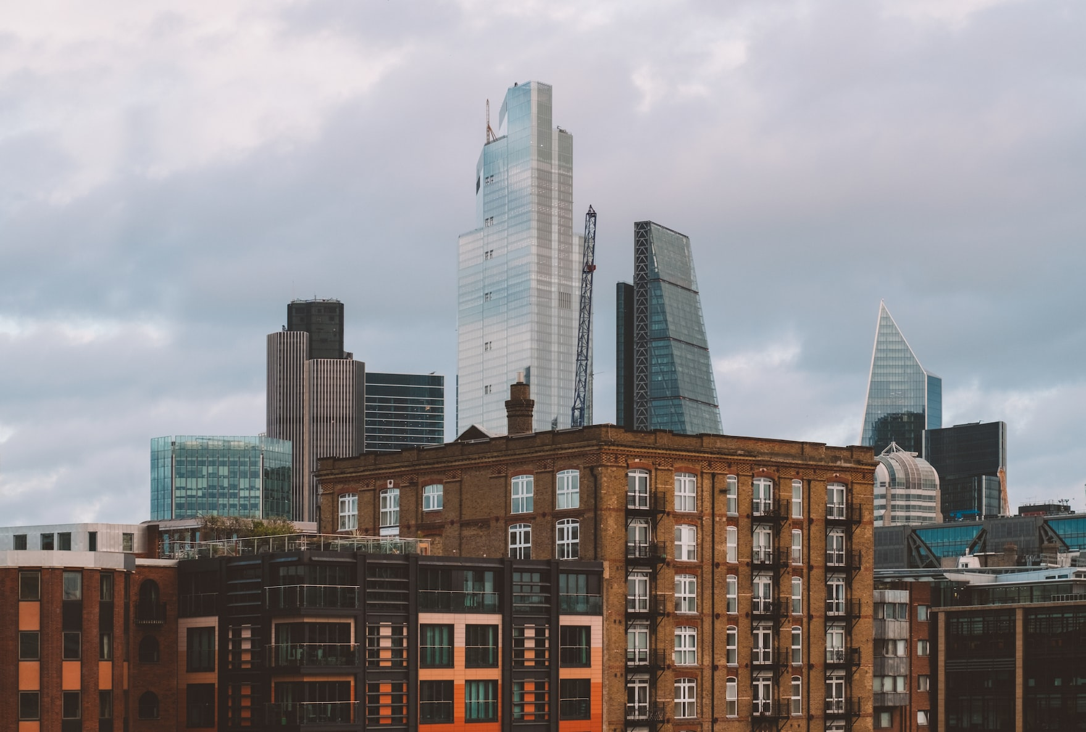
[Article Title]
Hello world Hello world Hello world Hello world Hello world Hello world Hello world Hello world Hello world Hello world Hello world Hello world

Slide 8
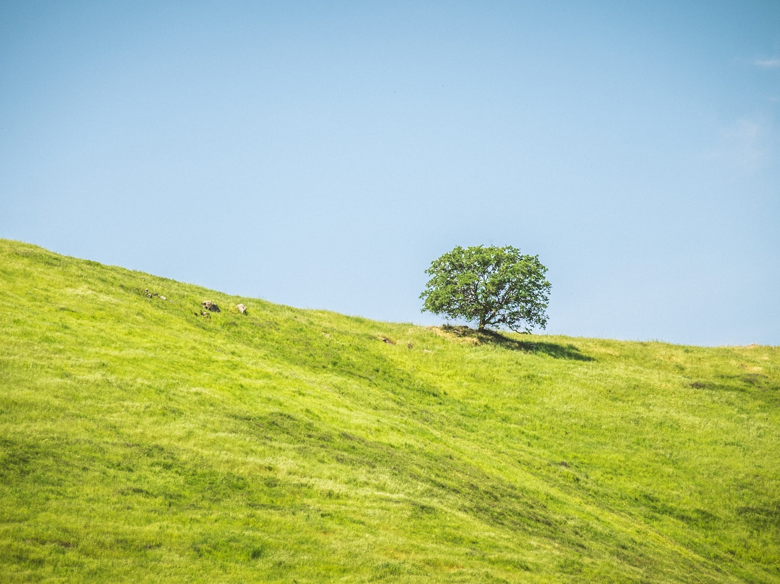
[Article Title]
Hello world Hello world Hello world Hello world Hello world Hello world Hello world Hello world Hello world Hello world Hello world Hello world

